Slide 1
Getting started with NHibernate

Slide 2
Agenda
Brief NHibernate overview
Simple contact list application

Slide 3
Why NHibernate
Uses POCOs
Mature
Lots of databases supported
Can be used in existing setups
Large ecosystem
Lazy loading
Caching
Notes:
Mature: version 3.1
Database support: sql server, oracle, db2, etc
Existing setups: Stored procedures, composite keys, id generators, mapping
Ecosystem: plugins. Caching, validation, auditing, fulltext searching

Slide 4
Components
Database
Entities (POCOs)
Mappings

Slide 5
XML Mapping
<hibernate-mapping>
<class>
<id name="Id" type="System.Int32”>
<column name="Id" />
<generator class="hilo">
<param name="max_lo">1000</param>
</generator>
</id>
<property name="Firstname" type="System.String”>
<column name="Firstname" />
</property>
</class>
</hibernate-mapping>

Slide 6
Fluent Mapping
Table("Person");
Id(x => x.Id).GeneratedBy.HiLo("1000");
Map(x => x.Firstname);

Slide 7
Getting data out
HQL
CreateQuery("from p in Person where p = :id“)...
Criteria
CreateCriteria<Person>().Add(Restrictions.Eq("Id", id))...
QueryOver
QueryOver<Person>().Where(x => x.Id == id)...
LINQ
Query<Person>().Where(x => x.Id == id)...
Get
Get<Person>(id)

Slide 8
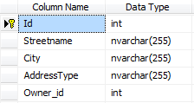
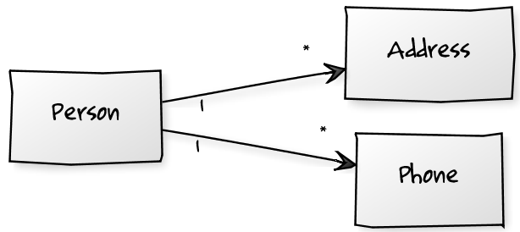
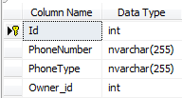
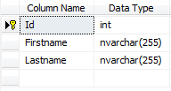
Demo

Slide 9
Source
Presentation source code
http://github.com/chripede/mow2011
NHibernate
http://nhforge.org/

